Slide 1








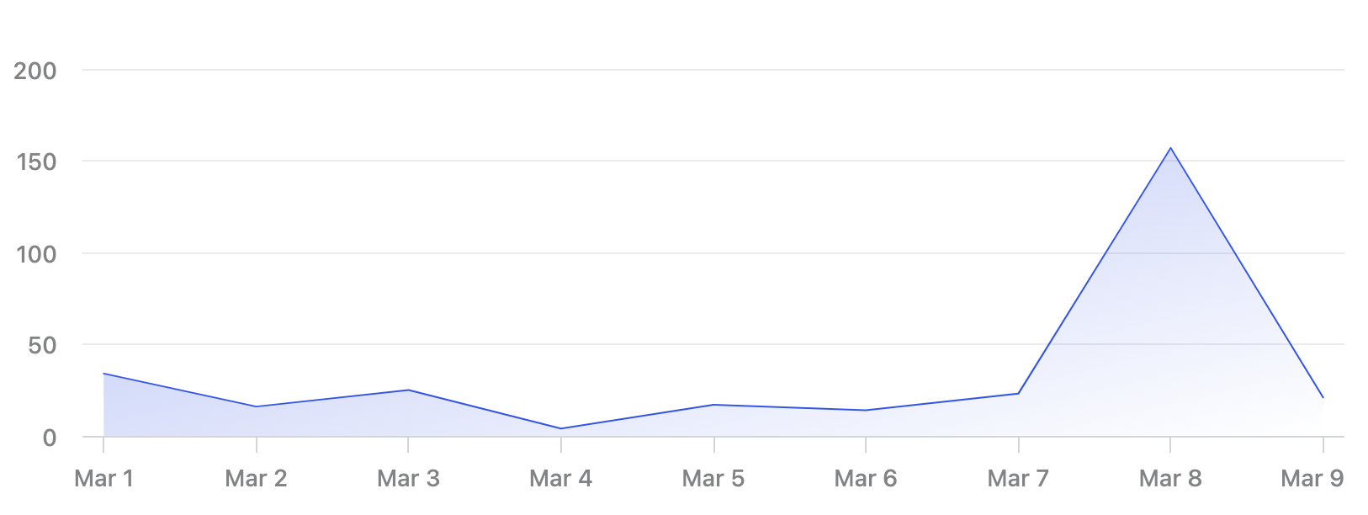
Clients
Smurfington Industries
Main Info
Contact name
M. Smurfs
Clients
Suppliers
Edit data
Main Info
Previous
Next

